Slide 1

Unit 5 COMBINATIONAL CIRCUITS-1 (Adder, Subtractor)
College of Computer and Information Sciences
Department of Computer Science
CSC 220: Computer Organization

Slide 2
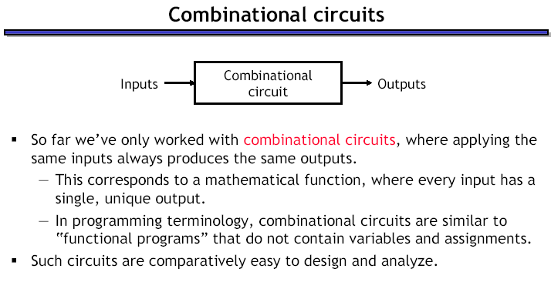

Slide 3
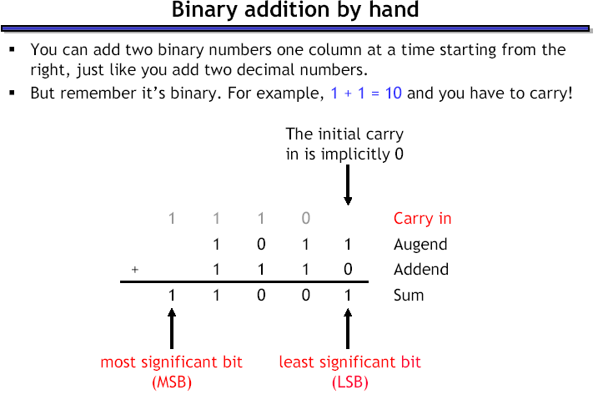

Slide 4
Adder
Design an Adder for 1-bit numbers?
1. Specification: 2 inputs (X,Y) 2 outputs (C,S)

Slide 5
Adder
Design an Adder for 1-bit numbers?
1. Specification: 2 inputs (X,Y) 2 outputs (C,S)
2. Formulation:
X | Y | C | S
0 | 0 | 0 | 0
0 | 1 | 0 | 1
1 | 0 | 0 | 1
1 | 1 | 1 | 0

Slide 6
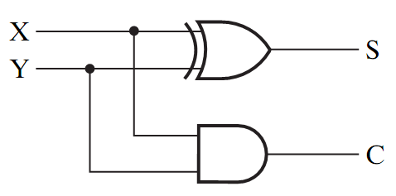
Adder
Design an Adder for 1-bit numbers?
1. Specification: 3. Optimization/Circuit 2 inputs (X,Y) 2 outputs (C,S)
2. Formulation:
X | Y | C | S
0 | 0 | 0 | 0
0 | 1 | 0 | 1
1 | 0 | 0 | 1
1 | 1 | 1 | 0

Slide 7
Half Adder
This adder is called a Half Adder
Q: Why?
X | Y | C | S
0 | 0 | 0 | 0
0 | 1 | 0 | 1
1 | 0 | 0 | 1
1 | 1 | 1 | 0

Slide 8
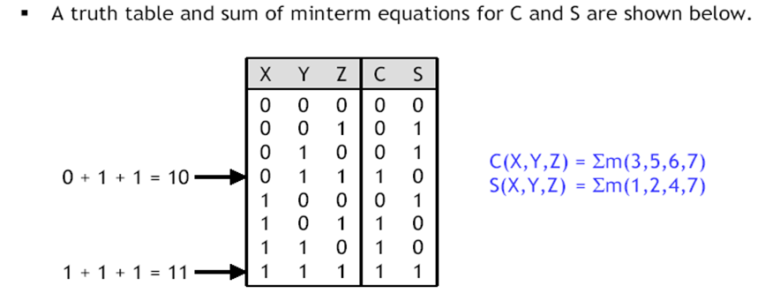
Full Adder
A combinational circuit that adds 3 input bits to generate a Sum bit and a Carry bit

Slide 9
Full Adder
A combinational circuit that adds 3 input bits to generate a Sum bit and a Carry bit
Sum
YZ
X | Y | Z | C | S
0 | 0 | 0 | 0 | 0
0 | 0 | 1 | 0 | 1
0 | 1 | 0 | 0 | 1
0 | 1 | 1 | 1 | 0
1 | 0 | 0 | 0 | 1
1 | 0 | 1 | 1 | 0
1 | 1 | 0 | 1 | 0
1 | 1 | 1 | 1 | 1
X
00 01 11 10
0
1
0 1 0 1
1 0 1 0
S = X’Y’Z + X’YZ’ + XY’Z’ +XYZ
= X ⊕ Y ⊕ Z
Carry
YZ
X
00 01 11 10
0
1
0 0 1 0
0 1 1 1
C = XY + YZ + XZ

Slide 10
Full Adder = 2 Half Adders
Manipulating the Equations:
S = X ⊕ Y ⊕ Z
C = XY + XZ + YZ

Slide 11
Full Adder = 2 Half Adders
Manipulating the Equations:
S = ( X ⊕ Y ) ⊕ Z
C = XY + XZ + YZ
= XY + XYZ + XY’Z + X’YZ + XYZ
= XY( 1 + Z) + Z(XY’ + X’Y)
= XY + Z(X ⊕ Y )

Slide 12
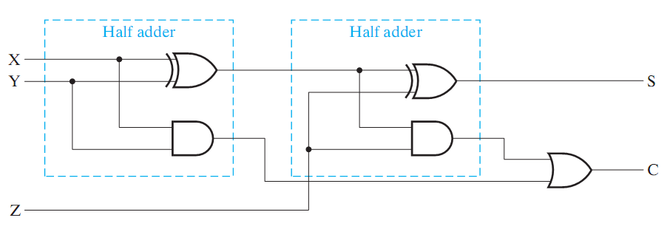
Full Adder = 2 Half Adders
Manipulating the Equations:
S = ( X ⊕ Y ) ⊕ Z
C = XY + XZ + YZ = XY + Z(X ⊕ Y )
Think of Z as a carry in
Src: Mano’s Book

Slide 13
Bigger Adders
How to build an adder for n-bit numbers?
Example: 4-Bit Adder
Inputs ?
Outputs ?
What is the size of the truth table?
How many functions to optimize?

Slide 14
Bigger Adders
How to build an adder for n-bit numbers?
Example: 4-Bit Adder
Inputs ? 9 inputs
Outputs ? 5 outputs
What is the size of the truth table? 512 rows!
How many functions to optimize? 5 functions

Slide 15
Binary Parallel Adder
To add n-bit numbers:
Use n Full-Adders in parallel
The carries propagates as in addition by hand
Use Z in the circuit as a C_{in}
1 0 0 0
0 1 0 1
0 1 1 0
1 0 1 1

Slide 16
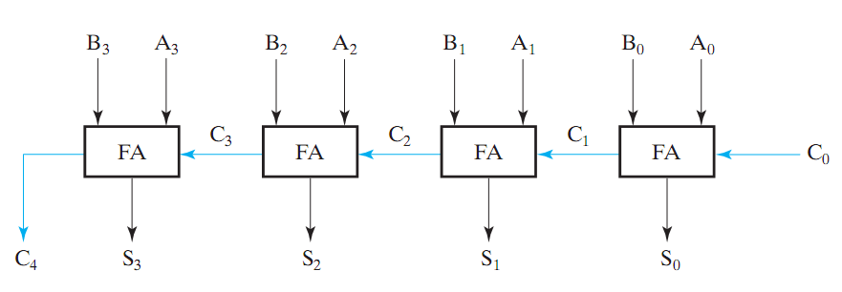
Binary Parallel Adder
To add n-bit numbers:
Use n Full-Adders in parallel
The carries propagates as in addition by hand
Src: Mano’s Book
This adder is called ripple carry adder

Slide 17
Subtraction (2’s Complement)
How to build a subtractor using 2’s complement?

Slide 18
Subtraction (2’s Complement)
How to build a subtractor using 2’s complement?
1
Src: Mano’s Book
S = A + ( -B)

Slide 19
Adder/Subtractor
How to build a circuit that performs both addition and subtraction?

Slide 20
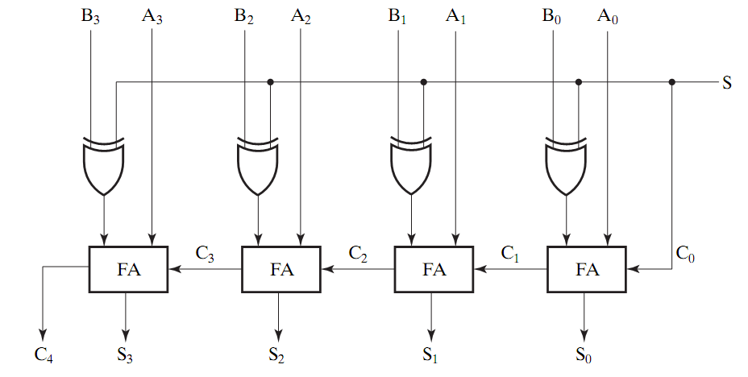
Adder/Subtractor
0 : Add
1: subtract
Src: Mano’s Book
Using full adders and XOR we can build an Adder/Subtractor!

Slide 21
Binary Parallel Adder (Again)
To add n-bit numbers:
Use n Full-Adders in parallel
The carries propagates as in addition by hand
Src: Mano’s Book
This adder is called ripple carry adder

Slide 22
Carry Look Ahead Adder
How to reduce propagation delay of ripple carry adders?
Carry look ahead adder: All carries are computed as a function of C₀ (independent of n !)
It works on the following standard principles:
A carry bit is generated when both input bits Ai and Bi are 1, or
When one of input bits is 1, and a carry in bit exists
Carry bits
Cn Cn-1…….Ci……….C2C1C0
An-1…….Ai……….A2A1A0
Bn-1…….Bi……….B2B1B0
Carry Out
Sn Sn-1…….Si……….S2S1S0

